Slide 1
Swift language
Repetition

Slide 2
Topics
Introduction to Repetition Structures
The while Loop: a Condition-Controlled Loop
The for Loop: a Count-Controlled Loop
Calculating a Running Total
Sentinels
Input Validation Loops
Nested Loops

Slide 3
Introduction to Repetition Structures
Often have to write code that performs the same task multiple times
Disadvantages to duplicating code
Makes program large
Time consuming
May need to be corrected in many places
Repetition structure: makes computer repeat included code as necessary
Includes condition-controlled loops and count-controlled loops

Slide 4
The while Loop: a Condition-Controlled Loop
while loop: while condition is true, do something
Two parts:
Condition tested for true or false value
Statements repeated as long as condition is true
In flow chart, line goes back to previous part
General format:
while (condition){
statements
}

Slide 5
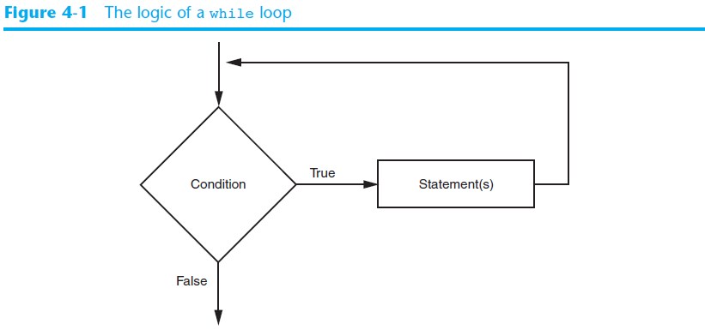
The while Loop: a Condition-Controlled Loop (cont’d.)

Slide 6
The while Loop: a Condition-Controlled Loop (cont’d.)
In order for a loop to stop executing, something has to happen inside the loop to make the condition false
Iteration: one execution of the body of a loop
while loop is known as a pretest loop
Tests condition before performing an iteration
Will never execute if condition is false to start with
Requires performing some steps prior to the loop

Slide 7
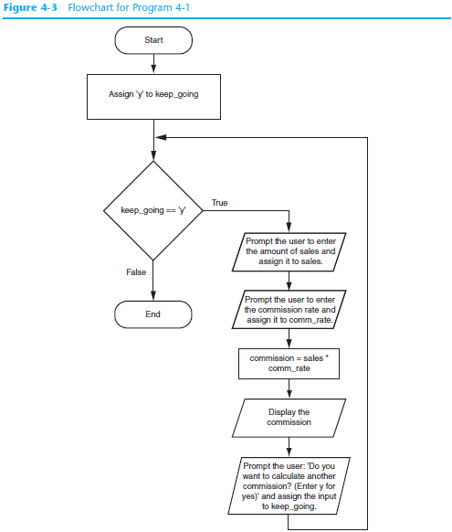

Slide 8
Infinite Loops
Loops must contain within themselves a way to terminate
Something inside a while loop must eventually make the condition false
Infinite loop: loop that does not have a way of stopping
Repeats until program is interrupted
Occurs when programmer forgets to include stopping code in the loop

